Slide 1
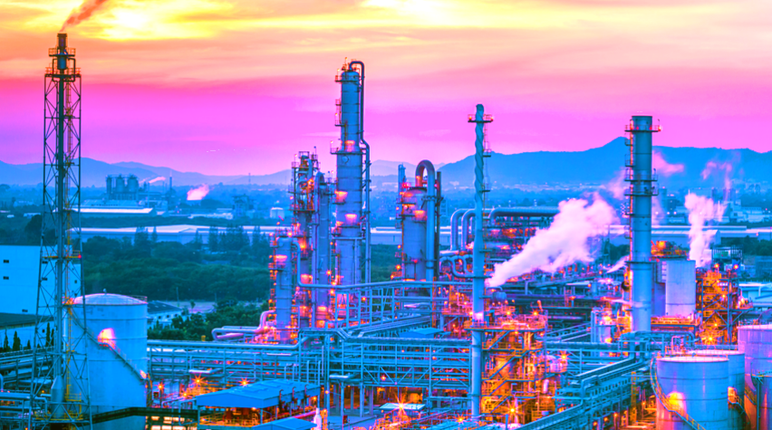

Slide 2
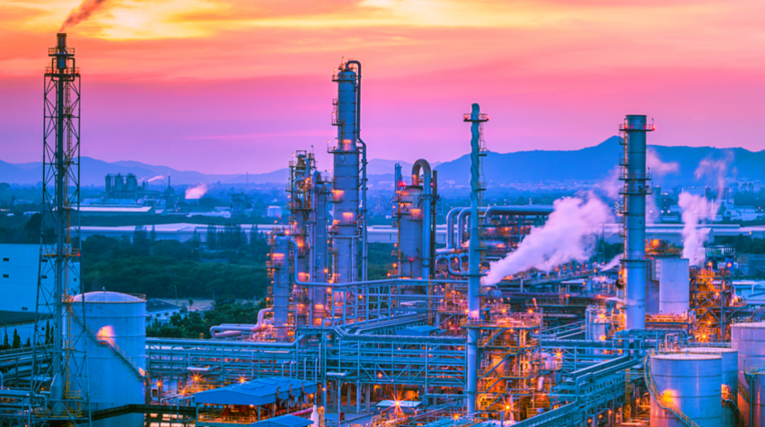
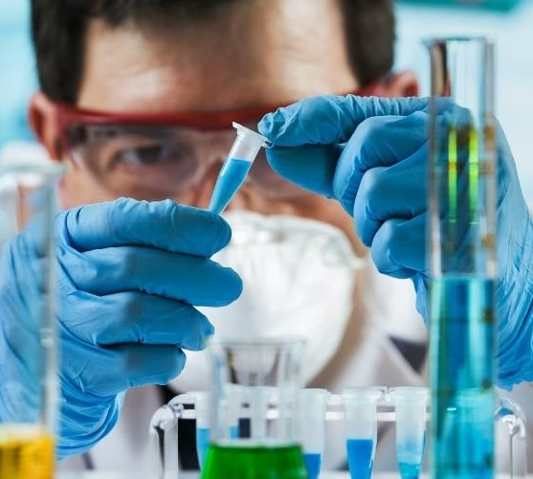

What do Chemical Engineers Do?
Chemical Engineers apply chemistry to engineering to solve problems related to food, drugs, and fuel.
Ensure products are made safely and in a environmentally safe manner
Test methods of production
Often works with large machinery or production facilities
Chemical Engineering Fields
Biochemical Engineer
Combines biology, chemistry, and engineering to develop medical products such as vaccines and environmentally friendly products.
Petroleum Engineer
Specializes in the production and refining of oil and natural gas
Food Engineer
Deals with food related issues, such as food safety and food preservation

Slide 3
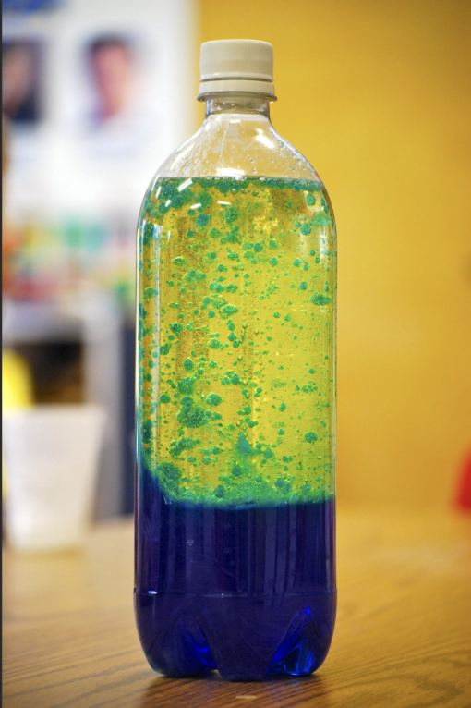
What do Chemical Engineers Do?
Chemical Engineers apply chemistry to engineering to solve problems related to food, drugs, and fuel.
Ensure products are made safely and in a environmentally safe manner
Test methods of production
Often works with large machinery or production facilities
Chemical Engineering Fields
Project: Creating a Lava Lamp
Biochemical Engineer
Combines biology, chemistry, and engineering to develop medical products such as vaccines and environmentally friendly products.
Petroleum Engineer
Specializes in the production and refining of oil and natural gas
Food Engineer
Deals with food related issues, such as food safety and food preservation
You will be creating a Lava Lamp according to the instructions sheet
Materials
Empty Container
Vegetable Oil and Water
Alka-Seltzer Tablet
Food Coloring
Instructions
Fill the roughly 75% of the container with Vegetable Oil and 25% with water
Drop in a Alka-Seltzer Tablet

Slide 4
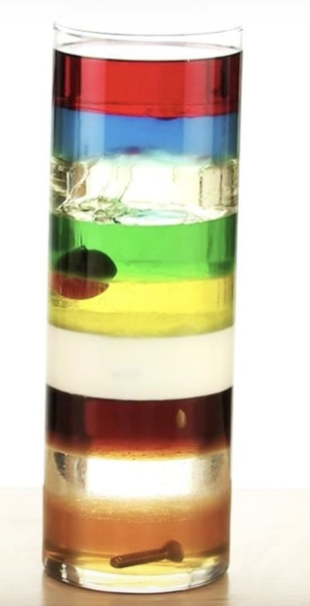
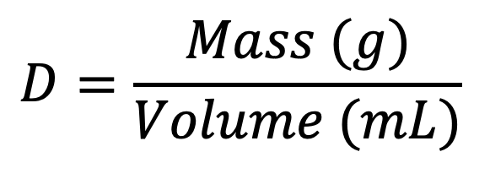
Chemical Engineering Fields
Project: Creating a Lava Lamp
Key Lesson: Density
Biochemical Engineer
Combines biology, chemistry, and engineering to develop medical products such as vaccines and environmentally friendly products.
Petroleum Engineer
Specializes in the production and refining of oil and natural gas
Food Engineer
Deals with food related issues, such as food safety and food preservation
You will be creating a Lava Lamp according to the instructions sheet
Materials
Empty Container
Vegetable Oil and Water
Alka-Seltzer Tablet
Food Coloring
Instructions
Fill the roughly 75% of the container with Vegetable Oil and 25% with water
Drop in a Alka-Seltzer Tablet
Density is how ‘light’ or ‘heavy’ an object is, relative to it’s size
For example, a bowling ball and a ballon might be roughly the same size, but the bowling ball weights a lot more than the ballon
This is because the bowling ball is more dense than the ballon.
Scientists calculate the density of an object by taking the mass of an object and dividing it by the volume.
$$D=\frac{Mass (g)}{Volume (mL)}$$
Notes:
Pass out the Instructions Sheet after the presentation to make sure students are focused on the PowerPoint (and not looking at the sheet)

Slide 5
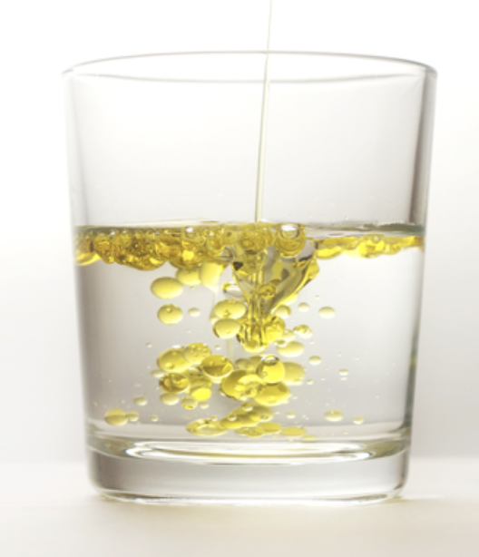
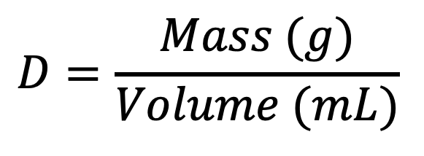
Key Lesson: Density
Key Lesson: Mixing
Project: Creating a Lava Lamp
Density is how ‘light’ or ‘heavy’ an object is, relative to it’s size
For example, a bowling ball and a ballon might be roughly the same size, but the bowling ball weights a lot more than the ballon
This is because the bowling ball is more dense than the ballon.
Scientists calculate the density of an object by taking the mass of an object and dividing it by the volume.
Oil and water are made up of different molecules
As a result, they do not mix
Oil is also less dense and lighter than water, so it rises to the top of the jar.
Food coloring is usually water based
Therefore, Food Coloring mixes with water, but not oil.
Lastly, air is lighter than both oil and water
You will be creating a Lava Lamp according to the instructions sheet
Materials
Empty Container
Vegetable Oil and Water
Alka-Seltzer Tablet
Food Coloring
Instructions
Fill the roughly 75% of the container with Vegetable Oil and 25% with water
Drop in a Alka-Seltzer Tablet
$$D=\frac{Mass (g)}{Volume (mL)}$$
Notes:
Point out on the left that oil is less dense than water

Slide 6
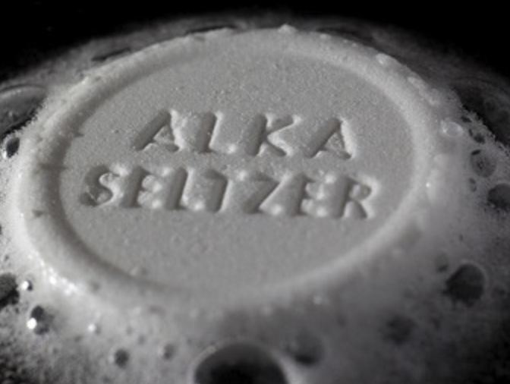
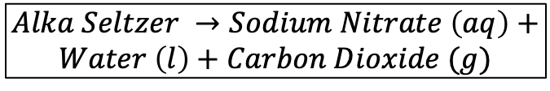
Key Lesson: Density
Key Lesson: Reactions
Key Lesson: Mixing
Density is how ‘light’ or ‘heavy’ an object is, relative to it’s size
For example, a bowling ball and a ballon might be roughly the same size, but the bowling ball weights a lot more than the ballon
This is because the bowling ball is more dense than the ballon.
Scientists calculate the density of an object by taking the mass of an object and dividing it by the volume.
Oil and water are made up of different molecules
As a result, they do not mix
Oil is also less dense and lighter than water, so it rises to the top of the jar.
Food coloring is usually water based
Therefore, Food Coloring mixes with water, but not oil.
Lastly, air is lighter than both oil and water
A chemical reaction occurs when a new molecule or a new type of material is formed
Dropping in a Alka-Seltzer Tablet causes a chemical reaction
Scientists use formulas to model chemical reactions
The reaction that occurs with the Alka-Seltzer tablet is:
Because gas (Carbon Dioxide) is less dense than oil, it will rise to the top, bringing water along with it.
$$Alka Seltzer →Sodium Nitrate \left(aq\right)+$$
$$Water \left(l\right)+Carbon Dioxide (g)$$
$$D=\frac{Mass (g)}{Volume (mL)}$$

Slide 7
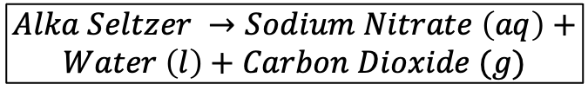
Key Lesson: Reactions
Key Lesson: Mixing
A chemical reaction occurs when a new molecule or a new type of material is formed
Dropping in a Alka-Seltzer Tablet causes a chemical reaction
Scientists use formulas to model chemical reactions
The reaction that occurs with the Alka-Seltzer tablet is:
Because gas (Carbon Dioxide) is less dense than oil, it will rise to the top, bringing water along with it.
Oil and water are made up of different molecules
As a result, they do not mix
Oil is also less dense and lighter than water, so it rises to the top of the jar.
Food coloring is usually water based
Therefore, Food Coloring mixes with water, but not oil.
Lastly, air is lighter than both oil and water
$$Alka Seltzer →Sodium Nitrate \left(aq\right)+$$
$$Water \left(l\right)+Carbon Dioxide (g)$$

Slide 8
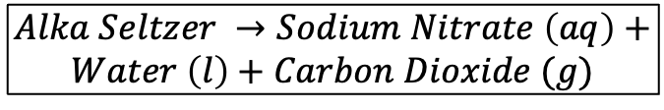
Application: Putting it all together
Key Lesson: Reactions
Key Lesson: Mixing
Look at the worksheet that we are passing out.
Your instructors gathered some data on Carbon Dioxide, Water, and Oil in the chart below (it’s also on your worksheet)
Using the density formula you learned, calculate the densities of each substance
Finish the rest of worksheet. Once your WHOLE group has finished the worksheet, you may get started on the lava lamp
A chemical reaction occurs when a new molecule or a new type of material is formed
Dropping in a Alka-Seltzer Tablet causes a chemical reaction
Scientists use formulas to model chemical reactions
The reaction that occurs with the Alka-Seltzer tablet is:
Because gas (Carbon Dioxide) is less dense than oil, it will rise to the top, bringing water along with it.
Oil and water are made up of different molecules
As a result, they do not mix
Oil is also less dense and lighter than water, so it rises to the top of the jar.
Food coloring is usually water based
Therefore, Food Coloring mixes with water, but not oil.
Lastly, air is lighter than both oil and water
Substance | Mass (grams) | Volume (mL)
Water (H₂O) | 75g | 75mL
Vegetable Oil (C₁₈H₃₄O₂) | 207g | 225mL
Carbon Dioxide (CO₂) | 2g | 1,015mL
$$Alka Seltzer →Sodium Nitrate \left(aq\right)+$$
$$Water \left(l\right)+Carbon Dioxide (g)$$

